Slide 1
Combination Of Targeted Temperature Management and Thrombectomy After Ischemic Stroke
COTTIS I / II

Slide 2
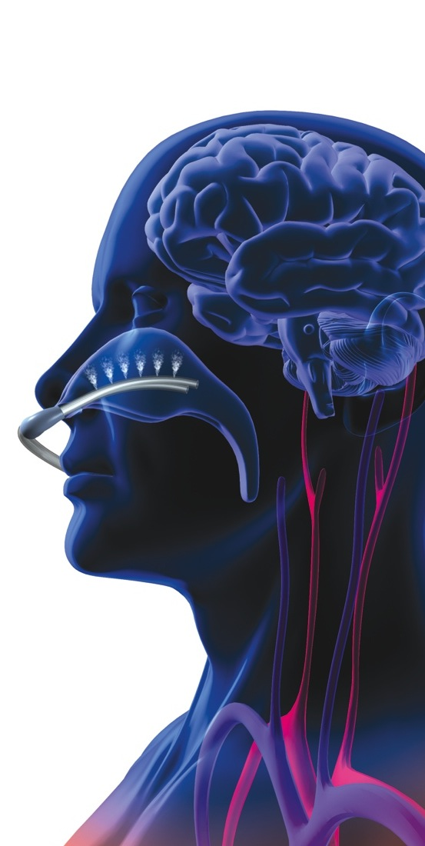
The success rate of thrombectomy (to reach a good outcome with mRS 0 – 2) after acute ischemic stroke today is 30% - 46%
The aim is to show that the combination of thrombectomy with early mild hypothermia (35°C) is able to increase significantly the success rate

Slide 3
Theoretical Considerations for hypothermia and stroke
High recanalisation rates clearly defined on angiography and reperfusion is needed for a lasting and effective neuroprotection by hypothermia
Existence of significant mismatch tissue in patients with large vessel occlusion, is the major target of hypothermia as a neuroprotectant
Patients with indication for thrombectomy usually recveive general anaesthesia with intubation and analgosedation. As a result, there is no discomfort or shivering caused by hypothermia
If hypothermia can be induced during ischemia (before recanalisation by thrombectomy!), the neuroprotective properties of hypohermia are optimally used, namely intra-ischemically and during the critical reperfusion phase after reopening of the vessel

Slide 4
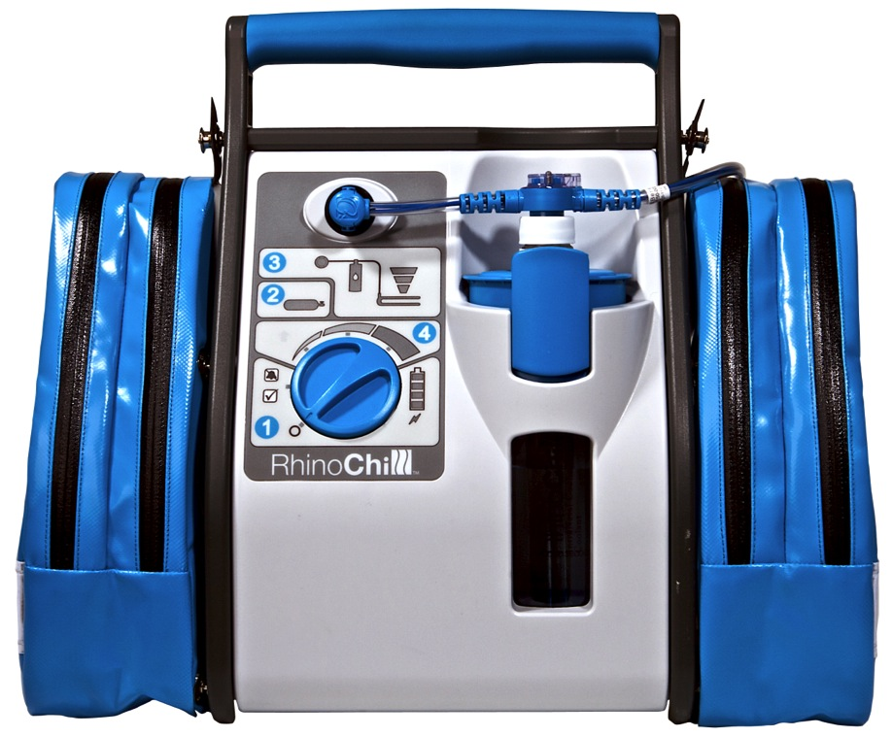
What do we use for rapid induction and maintenance of hypothermia?
Maintenance
Induction
+

Slide 5
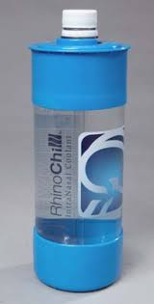
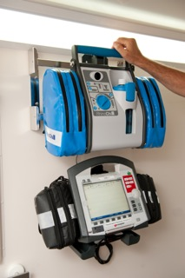
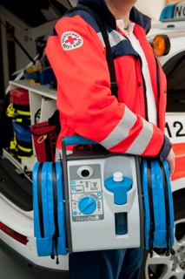
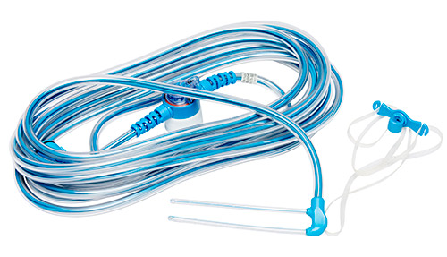
The portable, easy to use, Intranasal Cooling System (RhinoChill ®) for ultra-fast induction
2 l Coolant-Bottle
“RhinoChill®“ – Intranasal Cooling System
perfluorohexane
Intranasal Catheter

Slide 6
The RhinoChill® Principle
Conduction
~ 2°C
Evaporation
Convection

Slide 7
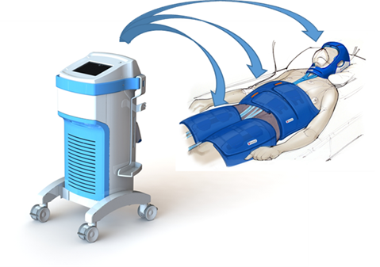
The “BrainCool System“ – for maintenance of the target temperature after thrombectomy and for active rewarming

Slide 8
Combination Of Targeted Temperature Management and Thrombectomy After Ischemic Stroke
COTTIS-1: design
a feasibility and safety study
Bardutzky J, et al. Stroke & Vascular Neurology 2023

Slide 9
Main inclusion criteria

Slide 10
Main inclusion criteria

Slide 11
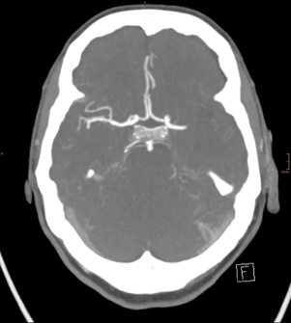
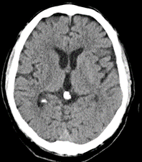
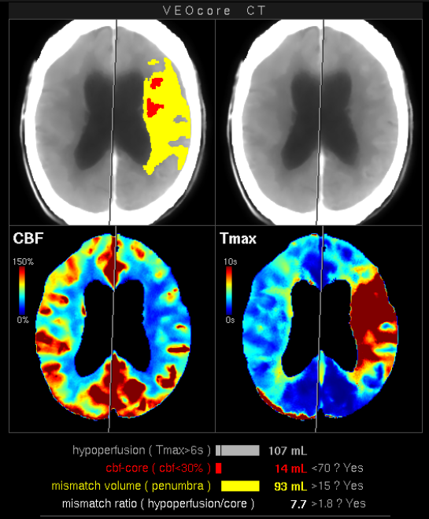
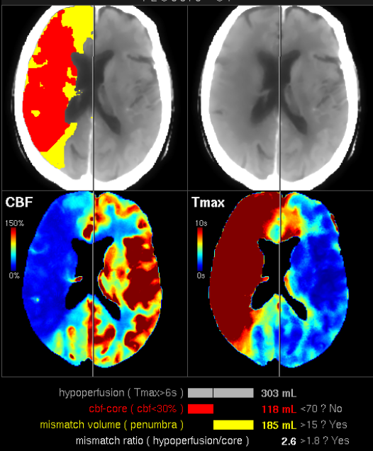
COTTIS-1: Imaging
<6h: CT and CT-A (or MRI/MR-A)
6-24h: significant mismatch in CT-Perfusion (or MRI(MRP)
core
penumbra
inclusion
no inclusion

Slide 12
COTTIS-1: design
Regular patient without hypothermia

Slide 13
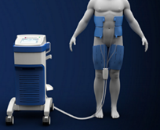
COTTIS-1: design
Hypothermia

Slide 14
Combination Of Targeted Temperature Management and Thrombectomy After Ischemic Stroke
COTTIS-1 : results
Bardutzky J, et al. Stroke & Vascular Neurology 2023

Slide 15
Patient characteristics (N=22)
Median age: 77 y
Median NIHSS on admission 15 (IQR 12.5-19.75)
Vessel Occlusion
M1 of MCA : 12 M2 of MCA : 3 Prox. ICA+M1 : 4 Carotid T : 3
Additional iv thrombolysis: 14 (64%)

Slide 16
Patient characteristics (N=22)
Median time from arrival
to initiate cooling: 57 minutes to start thrombectomy : 65 minutes to recanalisation : 123 minutes
The target temperature (35°C) was reached within 30 minutes (range 13-78 minutes)
Cooling rate: 2.6°C/h
All patients reached the target temperature
86% of the patients had reached 35°C at recanalisation by thrombectomy

Slide 17
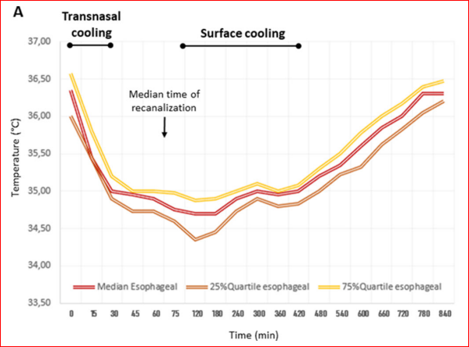
Course of oesophageal temperature

Slide 18
Side Effects
There were only asymptomatic side effects during hypothermia
Asymptomatic bradycardia: 32%
Nose bleed without need for intervention in one patient (5%)
There were no disturbances in electrolytes, renal function, coagulation cascade or smell and taste function

Slide 19
COTTIS I - Outcome
Good outcome
mRS 0
mRS 1
mRS 2
mRS 3
mRS 4
mRS 5
mRS 6
No Symptoms
Nonsignificant Disability
Slight Disability
Moderate Disability
Moderately Sever Disability
Sever Disability
Dead
68.2%

Slide 20
Matched-pair Analysis
Intervention: 22 COTTIS-1 patients
Controls: stroke registry at the same site with 851 consecutive patients undergoing thrombectomy from 2015 until 2022.
Matching factors: age, gender, NIHSS at admission, ASPECTS at admission, site of vessel occlusion and TICI- score.
Manuscript in preparartion

Slide 21
Patients characteristics
Variable | Control group n= 44 | Hypothermia (COTTIS) n= 22
Age, median (range ) | 76 (70-84) | 77 (70-83)
Occlusion site of vessel, n (%)
Distal ICA / + M1 | 29 (66%) | 15 (68%)
M2 | 7 (16%) | 3 (14%)
Tandem occlusion | 8 (18%) | 4(18%)
ASPECTS, median (range) | 9 (8,25-10) | 9 (8,25-10)
NIHSS, median (IQR) | 15 (12-18) | 15 (12,5-19,75)
Reperfusion, n (%)
TICI 0-2a | 3 (7%) | 2 (9%)
TICI 2b - 3 | 41 (93%) | 20 (91%)

Slide 22
Course of temperature
*
*
*
controls
*
*
*
hypothermia
* timepoints at 3h, 6h and 12h: p<0.001

Slide 23
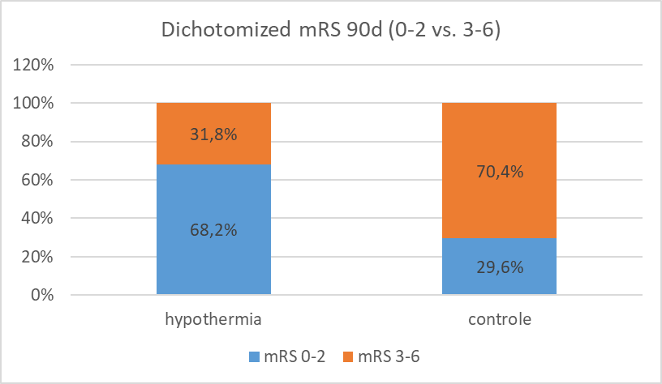
Primary endpoint: dichotomized mRS 0-2 vs 3-6 after 90days
Hypothermia: OR 5.1 (1.69; 15.38) for good outcome
p= .003

Slide 24
The promising results of the COTTIS I Study give us reasons to do the next step!

Slide 25
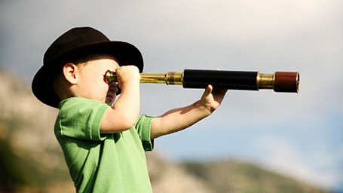
Ongoing Clinical Trial in Stroke – The COTTIS II
5 sites in Germany
400 patients ( two interim analysis 100, 200 )
Expected start date: February 2024
Expected completed recruitment : Within 2025 /2026
Primary outcome: Improvement of neurological outcome measured by mRS at day 90 after stroke

Slide 26
Thank you for your attention!

